Slide 1
Notre Dame Chemical Engineering
Professors
Troy Vogel and Mark McCready

Slide 2
Are you a chemical Engineer?… We really need your help!
Mark J McCready

Slide 3
Outline
Some preliminary info
What is special about chemical engineers.
Some likely future contributions to society!
  Energy
  Healthcare
My last try at what I thought was a clever slide!

Slide 4
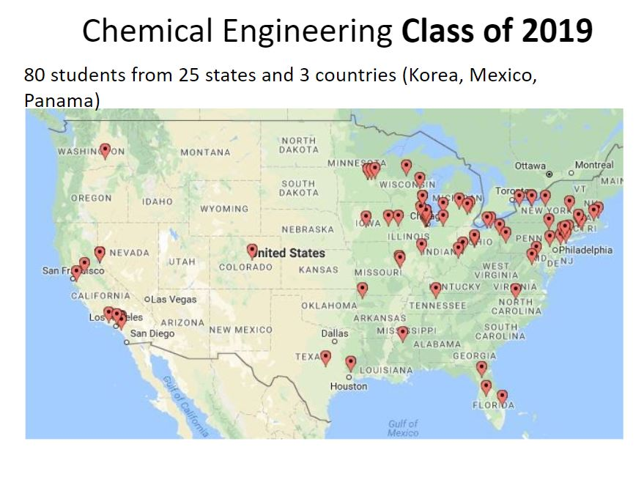
Chemical Engineering Class of 2021

Slide 5
2019 Class employment destinations
84.51°
AbbVie
Accenture
Apache Corporation
ARCCO/Murray
Beghou Consulting
Booz Allen Hamilton
Clarion Consulting
Clearsulting Analyst
Deloitte
Dow Chemical
Eli Lilly
Epic Systems
ExxonMobil
Fiat Chrysler Automobiles
Gates Corporation
GE Healthcare
Globalfoundries
Green Tweed and Co.
Javlyn Process Systems
Keyence Corp
Kymanox
McDermott International
McKinsey
P&G
PPG Manufacturing Development Program
Protiviti
PwC
Renaissance Lakewood, LLC
restor3d
Savannah River Nuclear Solutions
Siemens Healthcare
Ultracell LLC
Unilever
United States Steel Corporation
W.R. Grace & Co.
University of Chicago Medical School
University of Cincinnati Medical School
University of Washington - PhD Bioengineering
UC Berkeley - PhD in Chemical Engineering
UNC/NC State Grad School
Rice University (PhD)
Purdue University Graduate School
MSM program at ND
Brown University
Princeton University Research Associate
RPI (PhD)
volunteer (Glenmary Home Missionaries)
Navy Nuclear Power School
Marine Propulsion-Naval Nuclear Laboratory

Slide 6
Observation (to students)
While some of you may for a large chemical or petroleum company where there are other chemical engineers also employed…
You can see that most will be working where a great deal of your value to the company is what you know— that no one else in the room or building does.

Slide 7
Chemical engineering
Chemical understanding of matter and ability to apply quantitative analysis tools on scales from molecules to cubic meters
  Molecular thermodynamics: Phase/chemical equilibrium
  Comprehensive treatment of transport phenomena including chemical reactions
  Analysis procedures that combine conservation and rate equations that can describe individual devices or complete process across all of these scales
All of this can be applied beyond chemical process technology to the environment, physiological/living systems and various other industrial sectors.

Slide 8
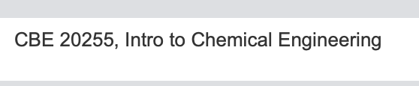
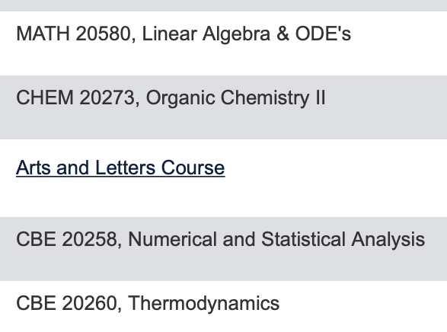
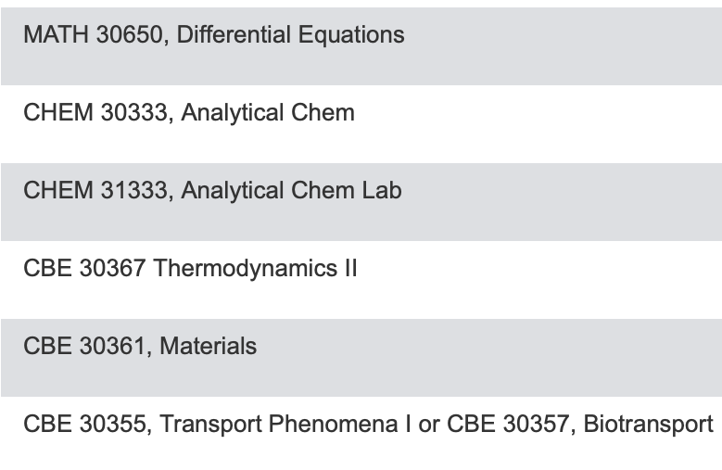
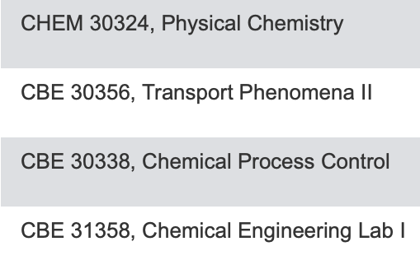
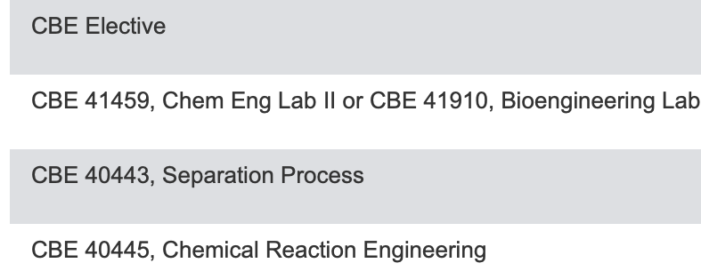
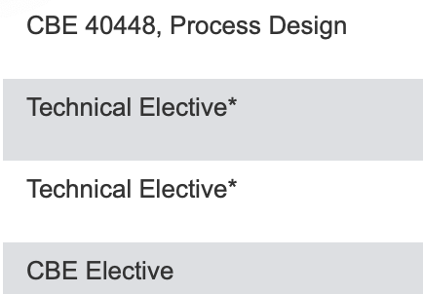
Curriculum Highlights
Topics of lasting and far reaching value!

Slide 9
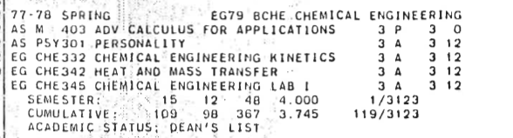
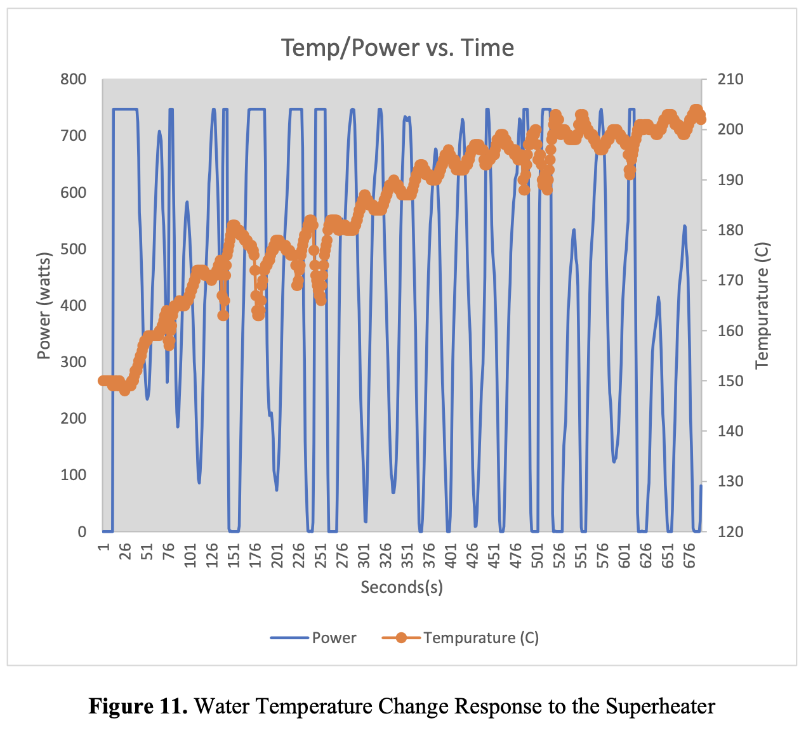
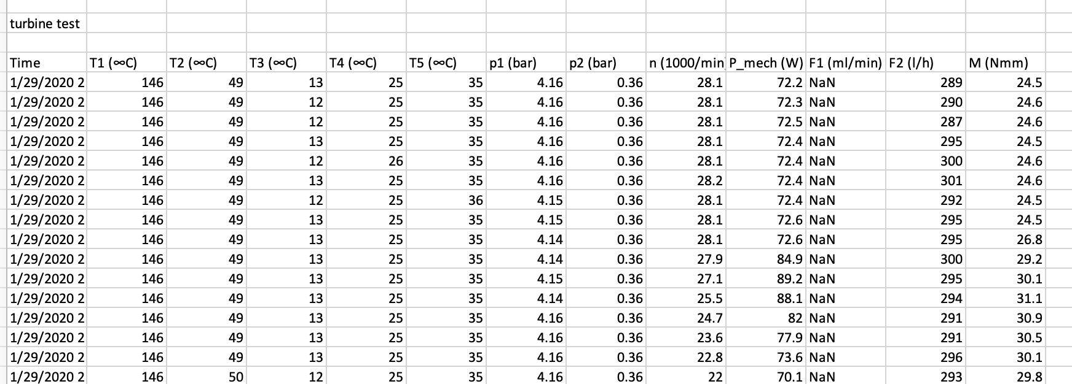
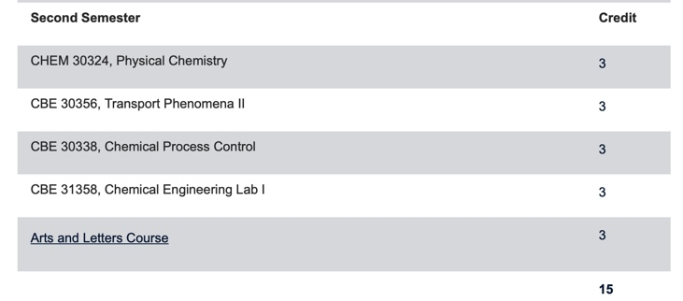
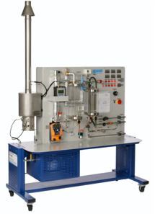
1978 —University of Delaware
2020 — University of Notre Dame
absolutely on-point abstract for project report!
Data by Peter Giannini, Elise Wellman and Maria Lengwin
2020 — University of Notre Dame

Slide 10
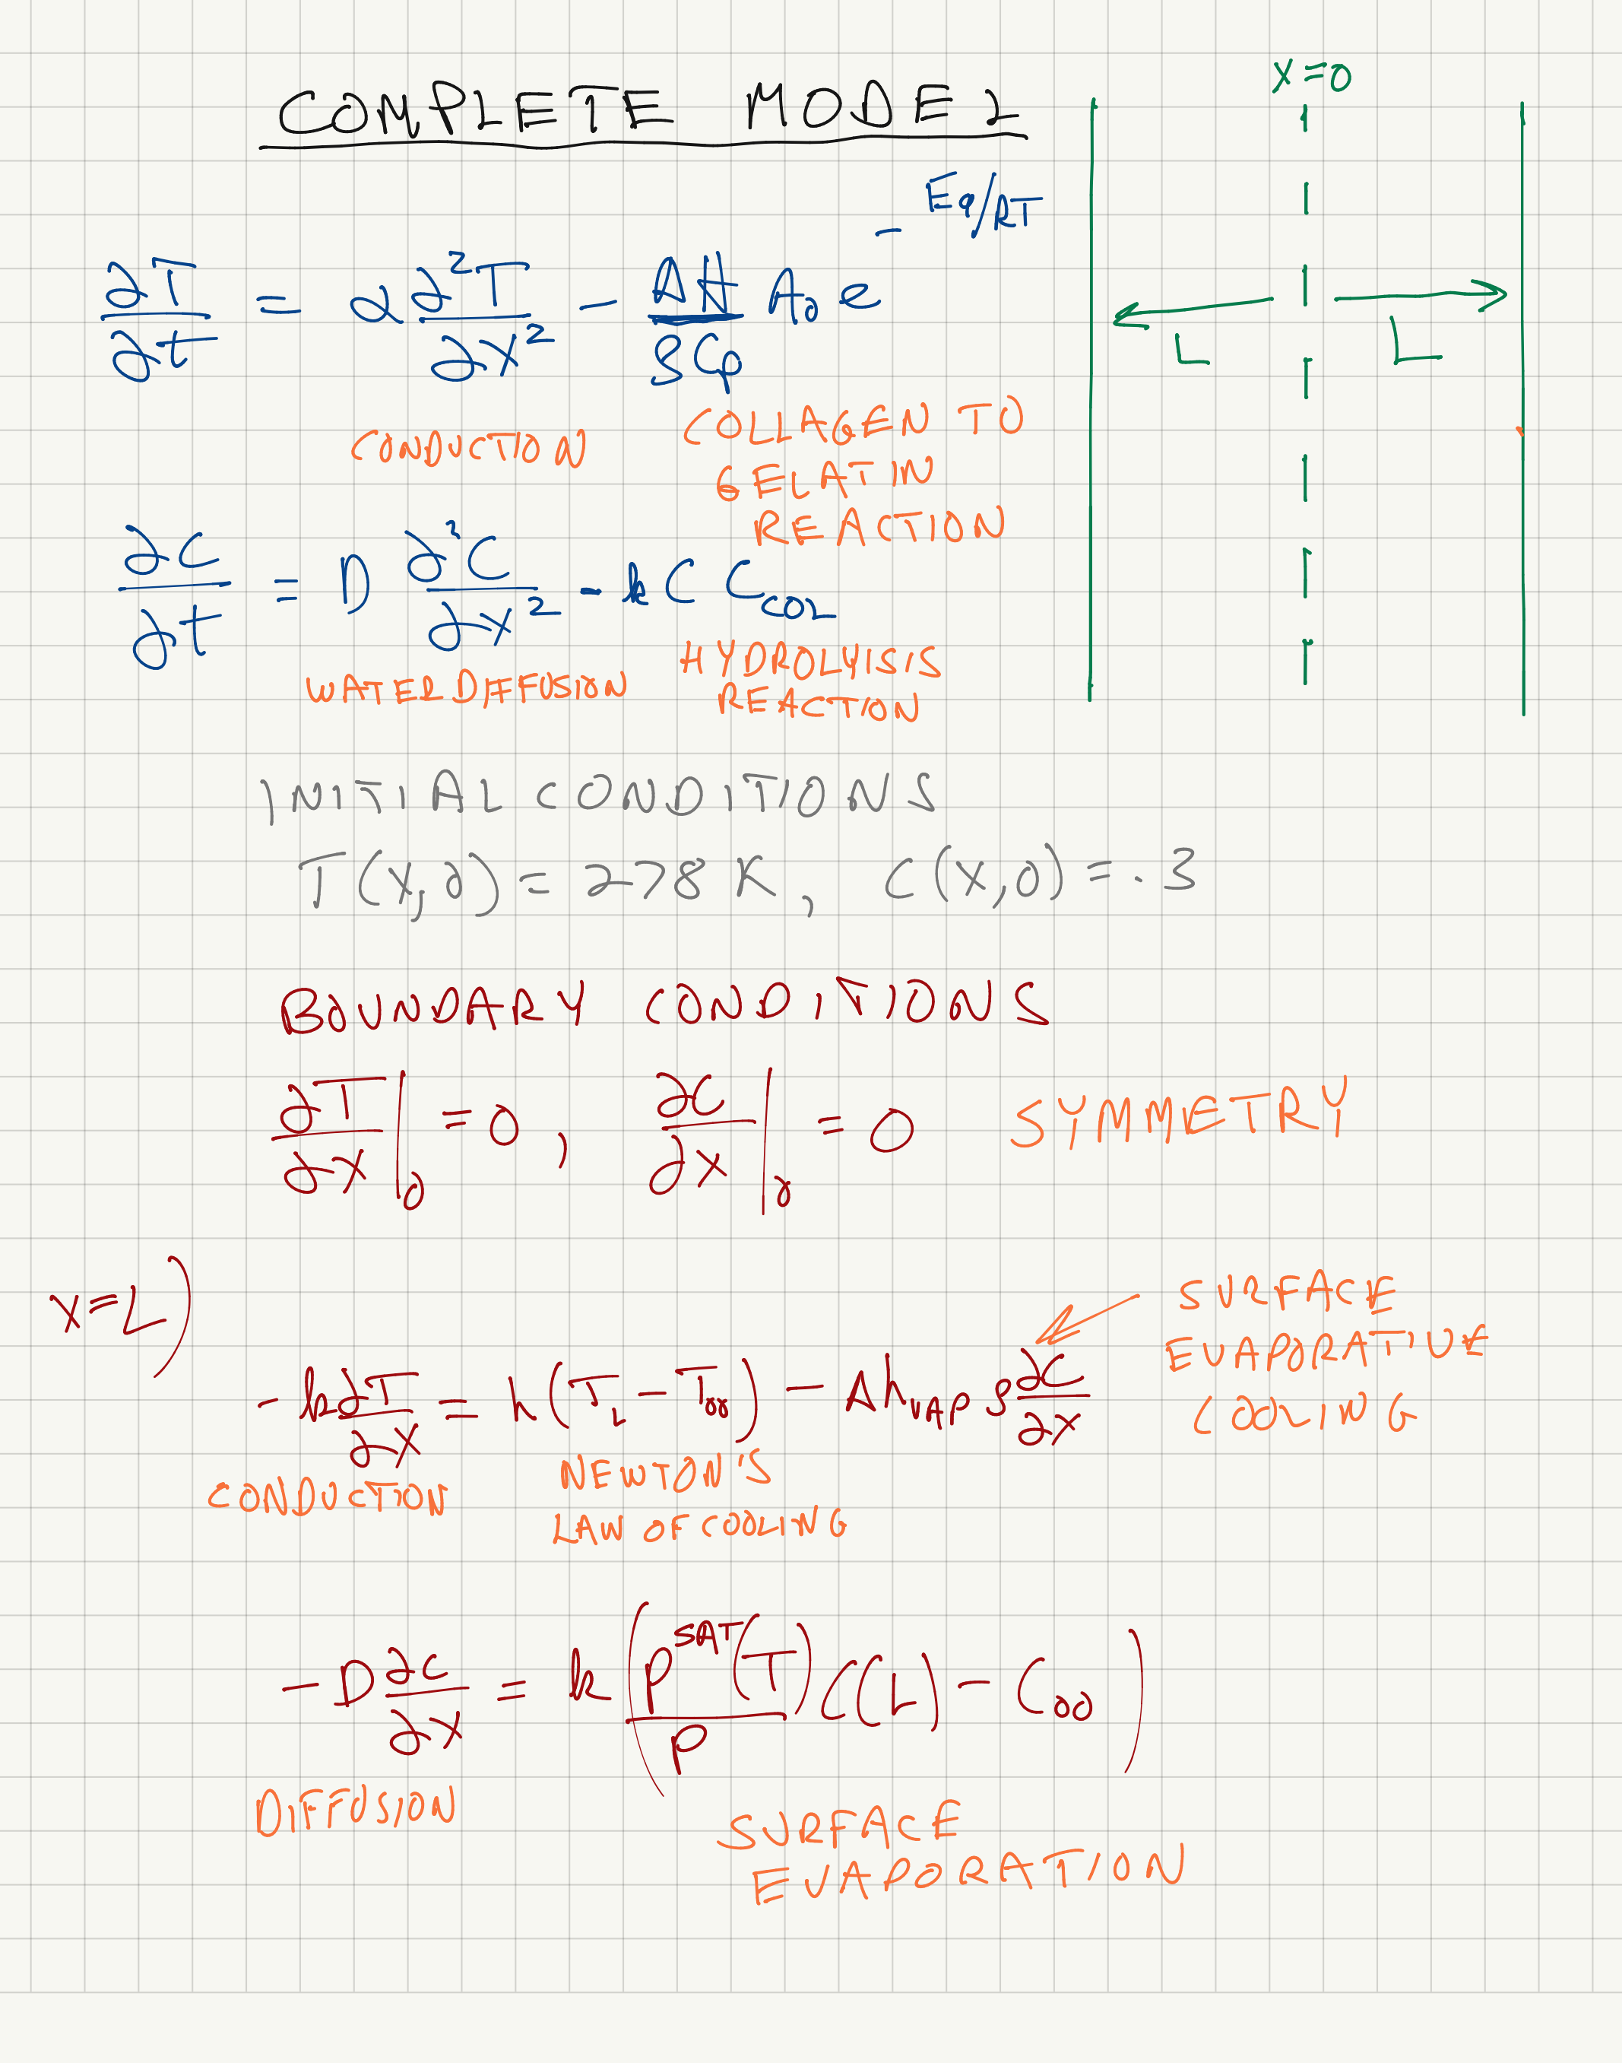
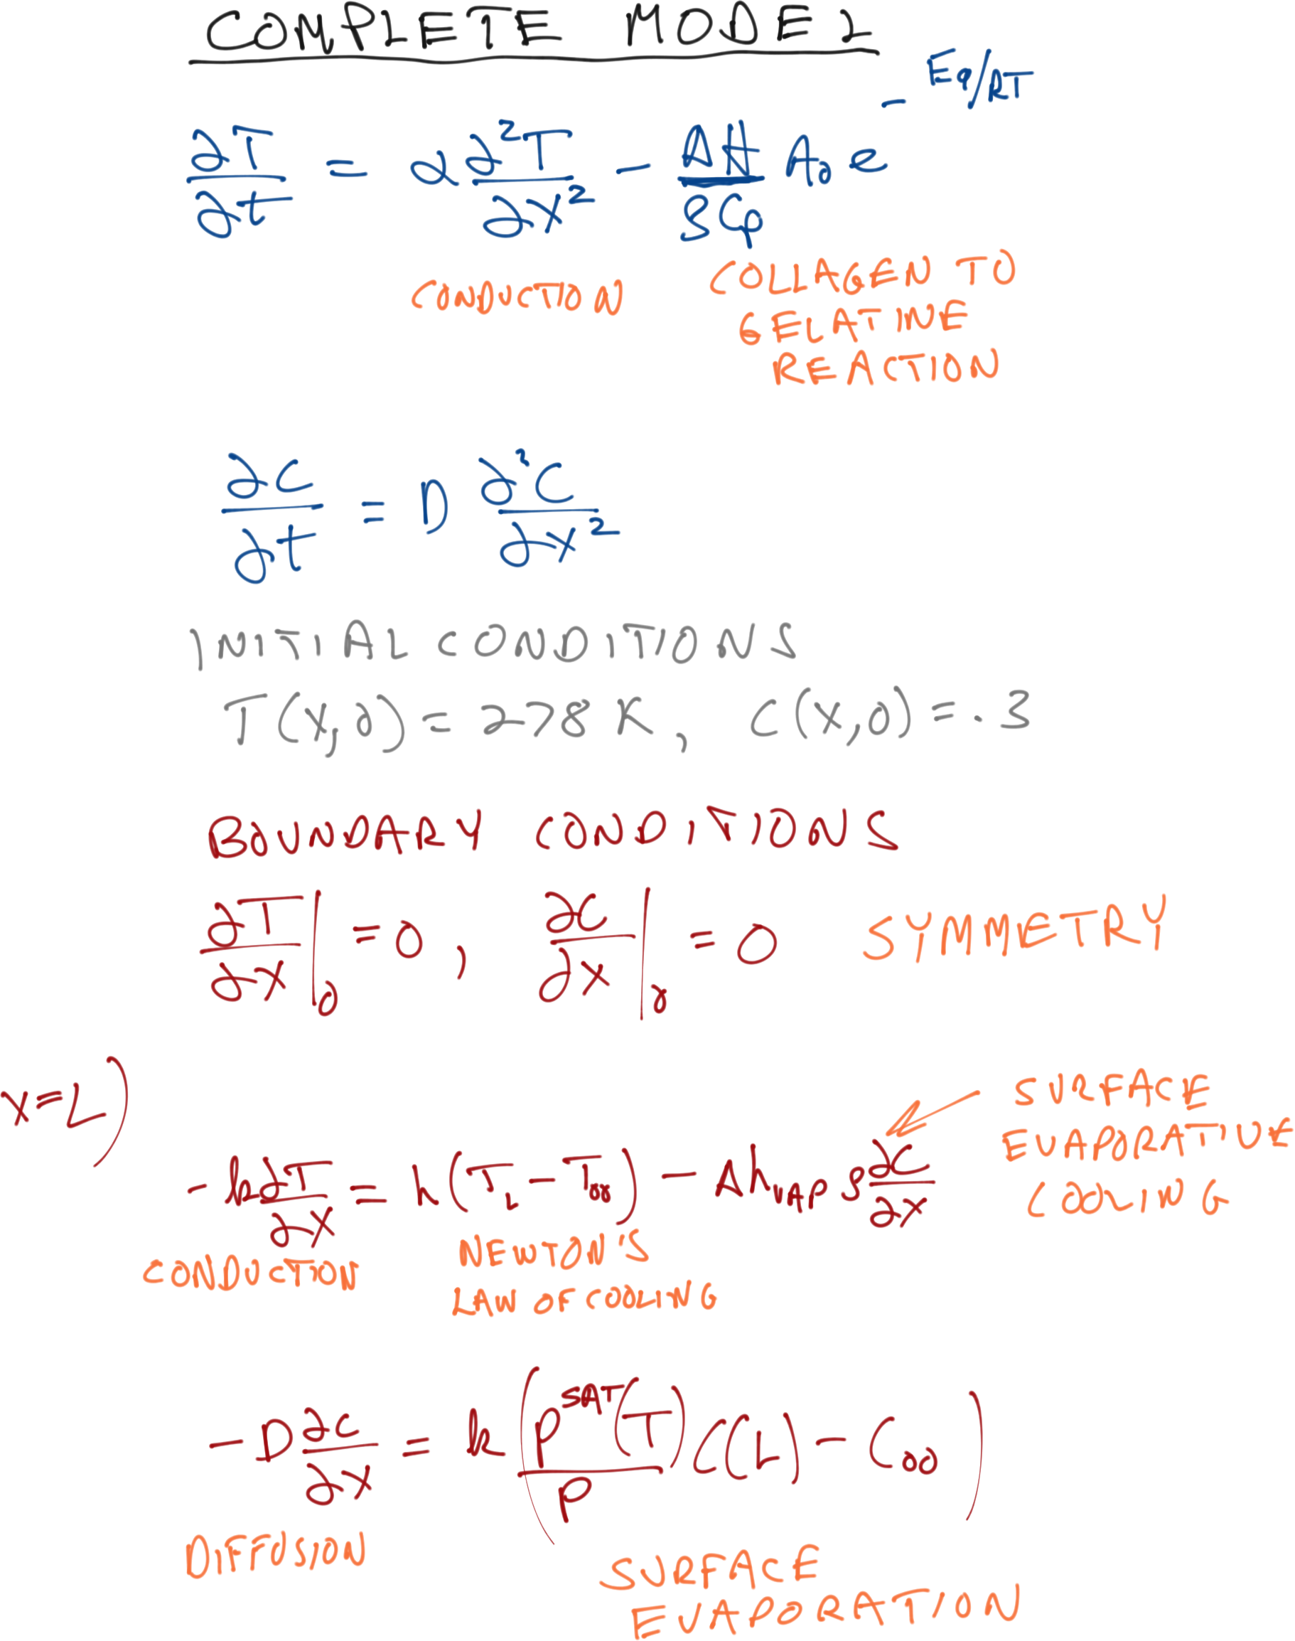
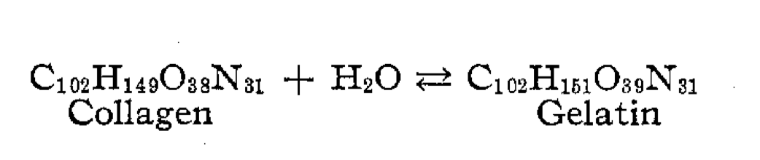

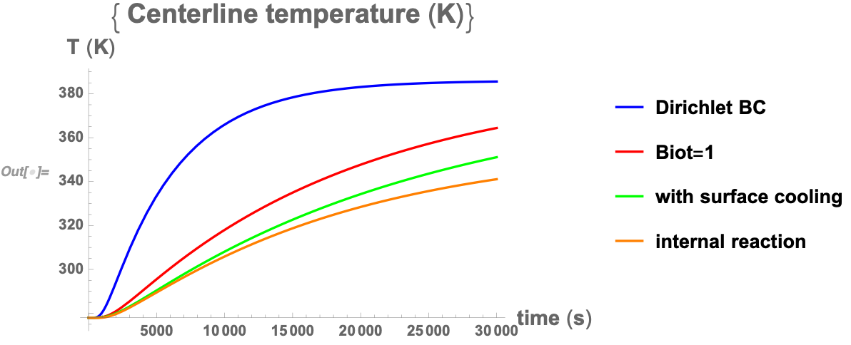
I guess you don’t have to use equations to cook ribs!

Slide 11
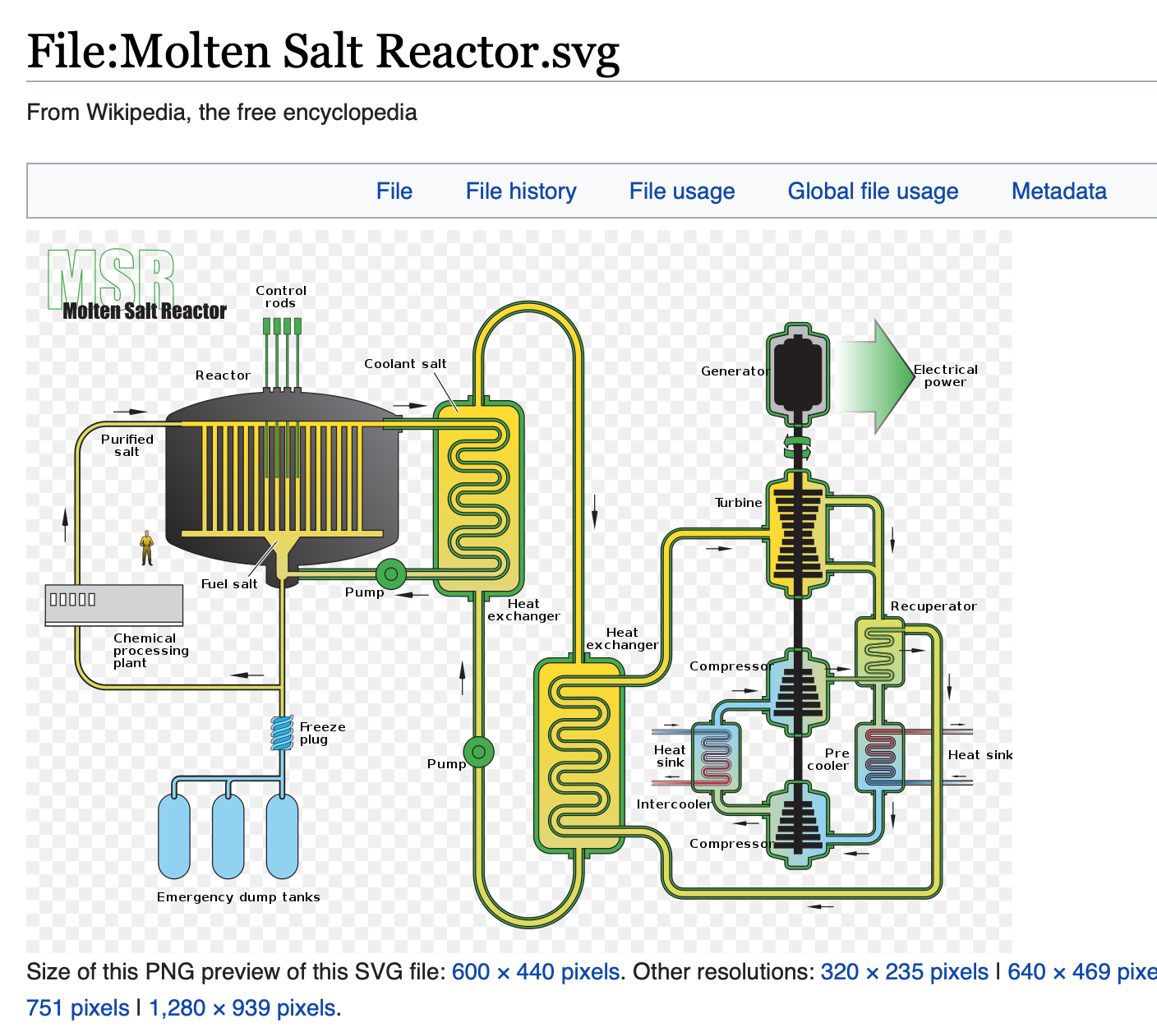
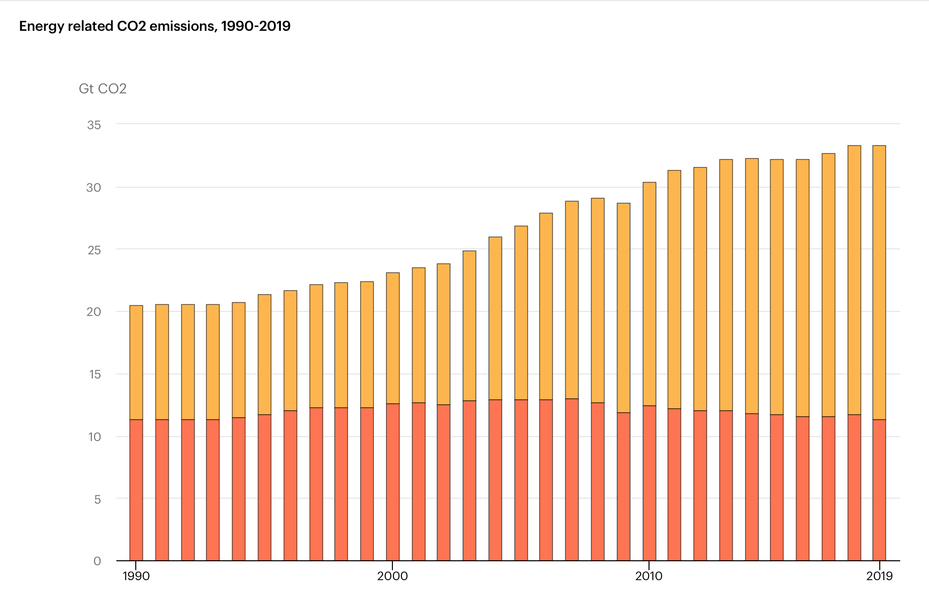

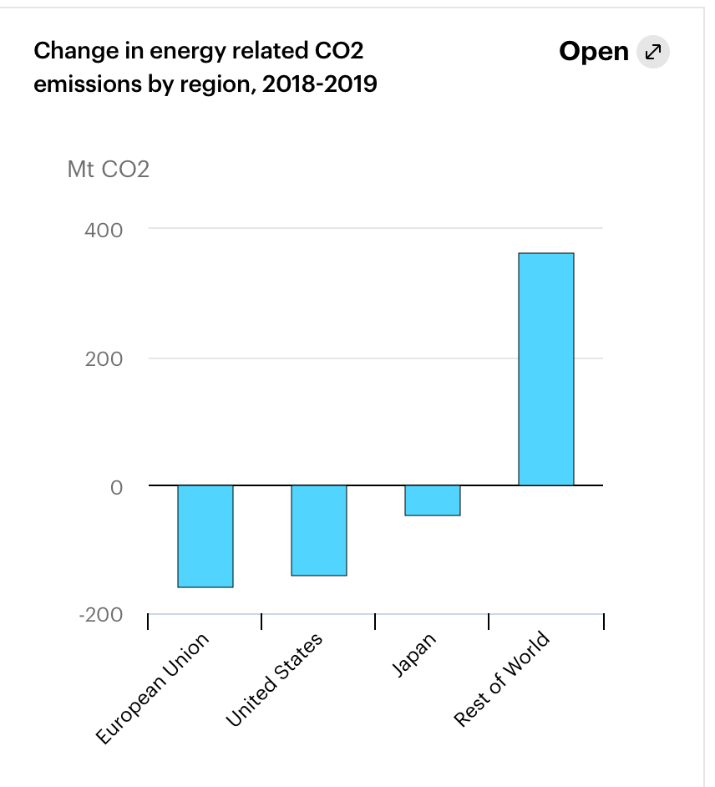
Energy
Next generation nuclear power
Chemical Engineering:
Molten salt: Thorium and Uranium are dissolved in salt mixture, need to understand this phase behavior, transport properties and materials of construction.
Prof Maginn works on some of these problems

Slide 12
Energy
Maybe even CO2 capture…

Slide 13
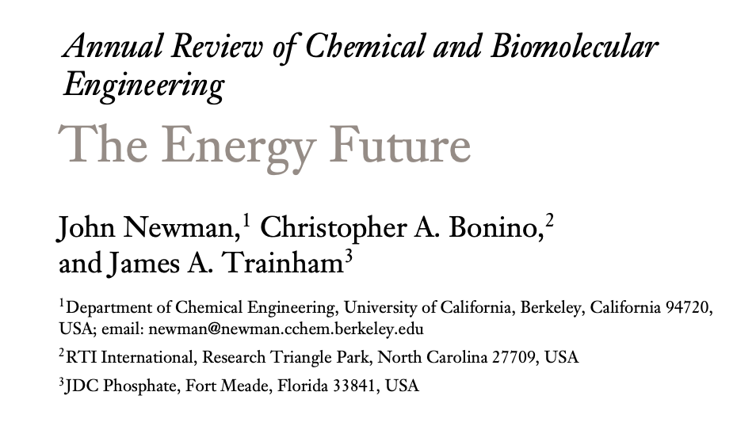
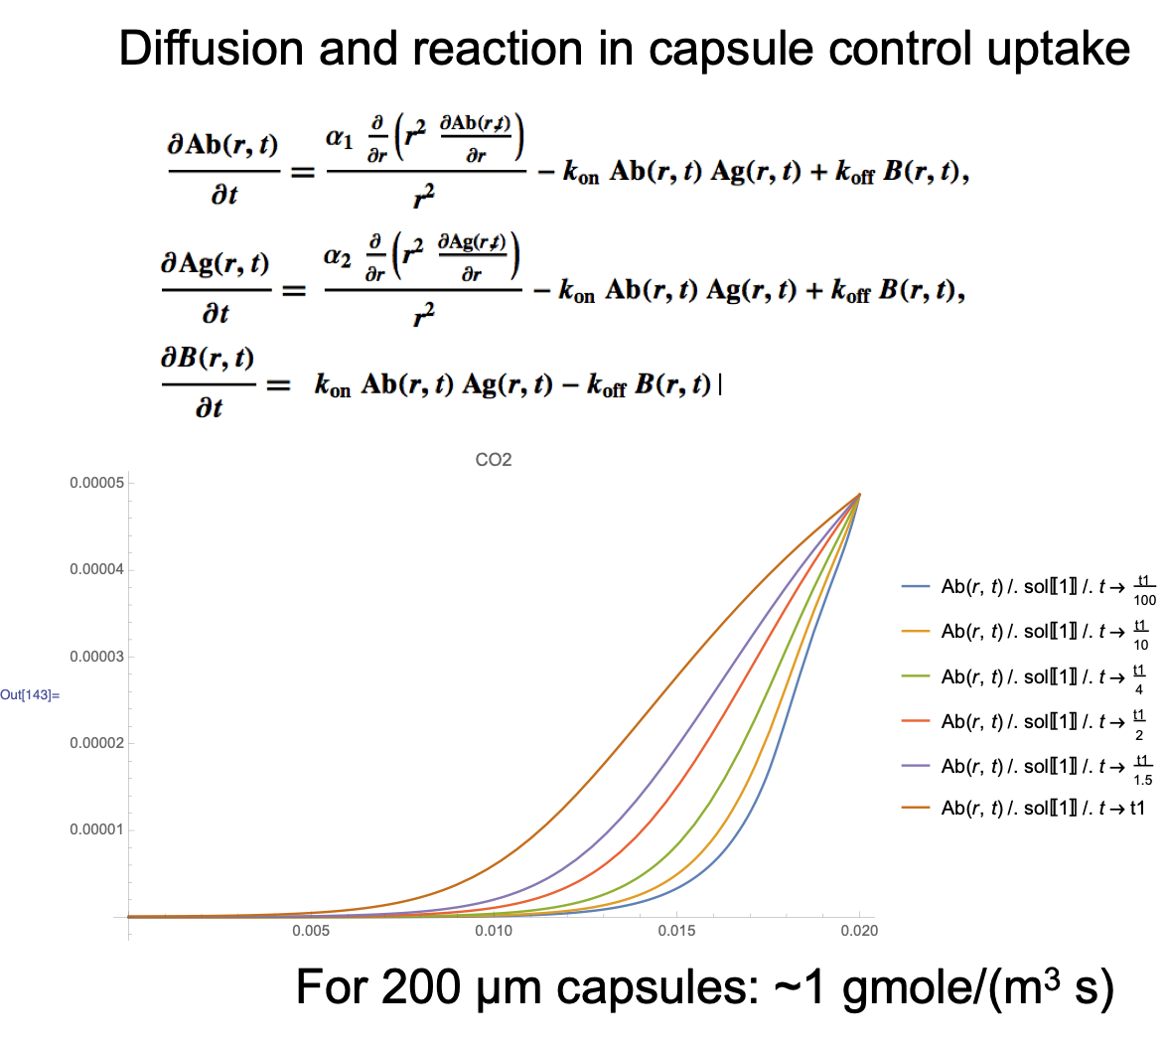
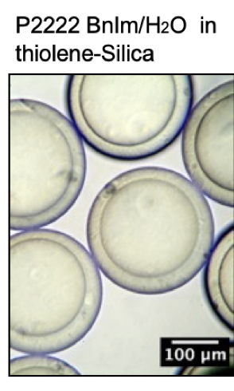
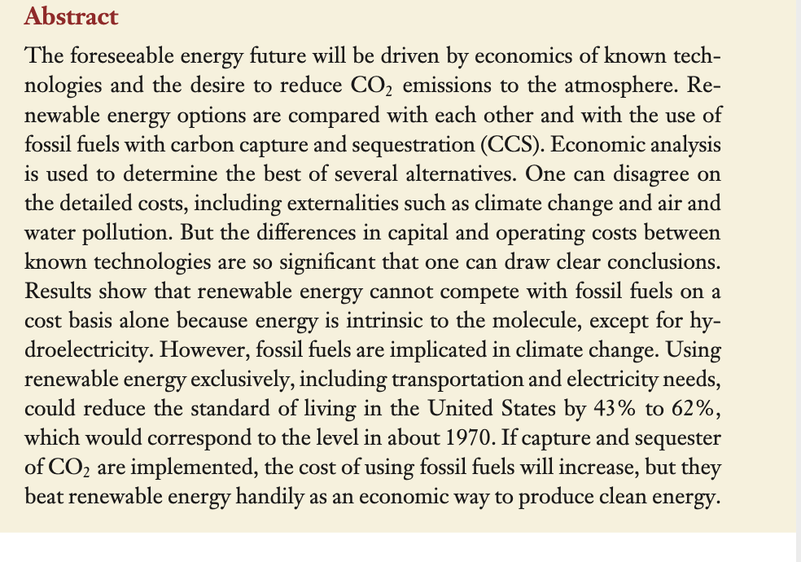
Energy:Who would have thought!
Ionic liquid encapsulated in silicon based polymer
Capturing CO2 might work for many processes

Slide 14
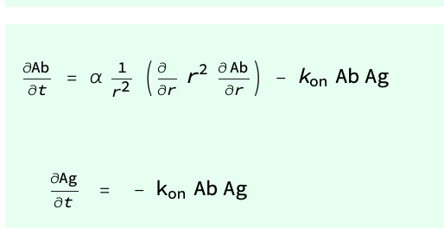
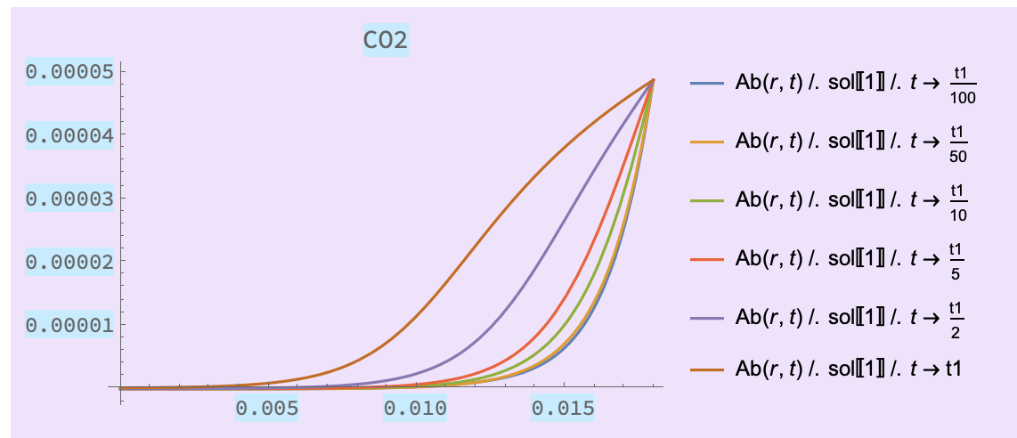
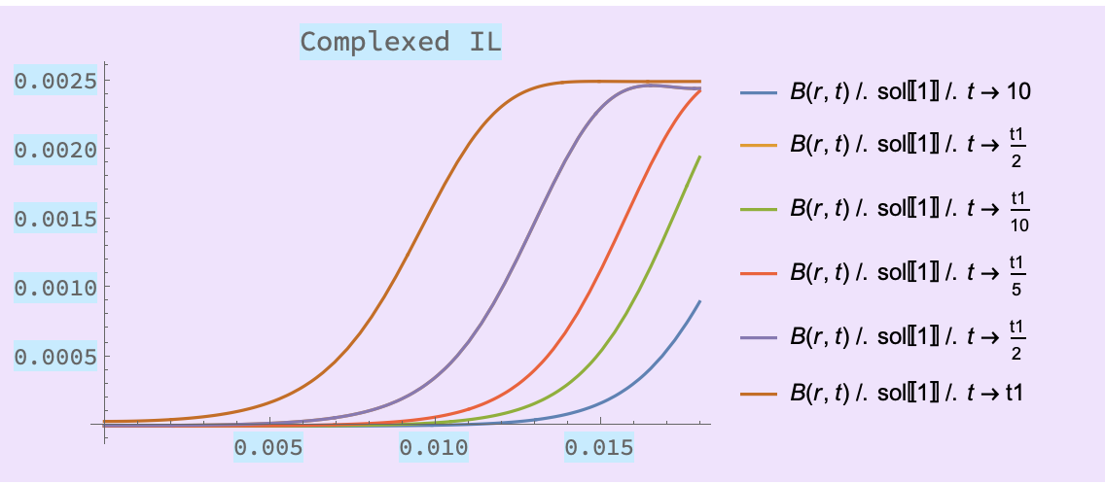
Transport

Slide 15


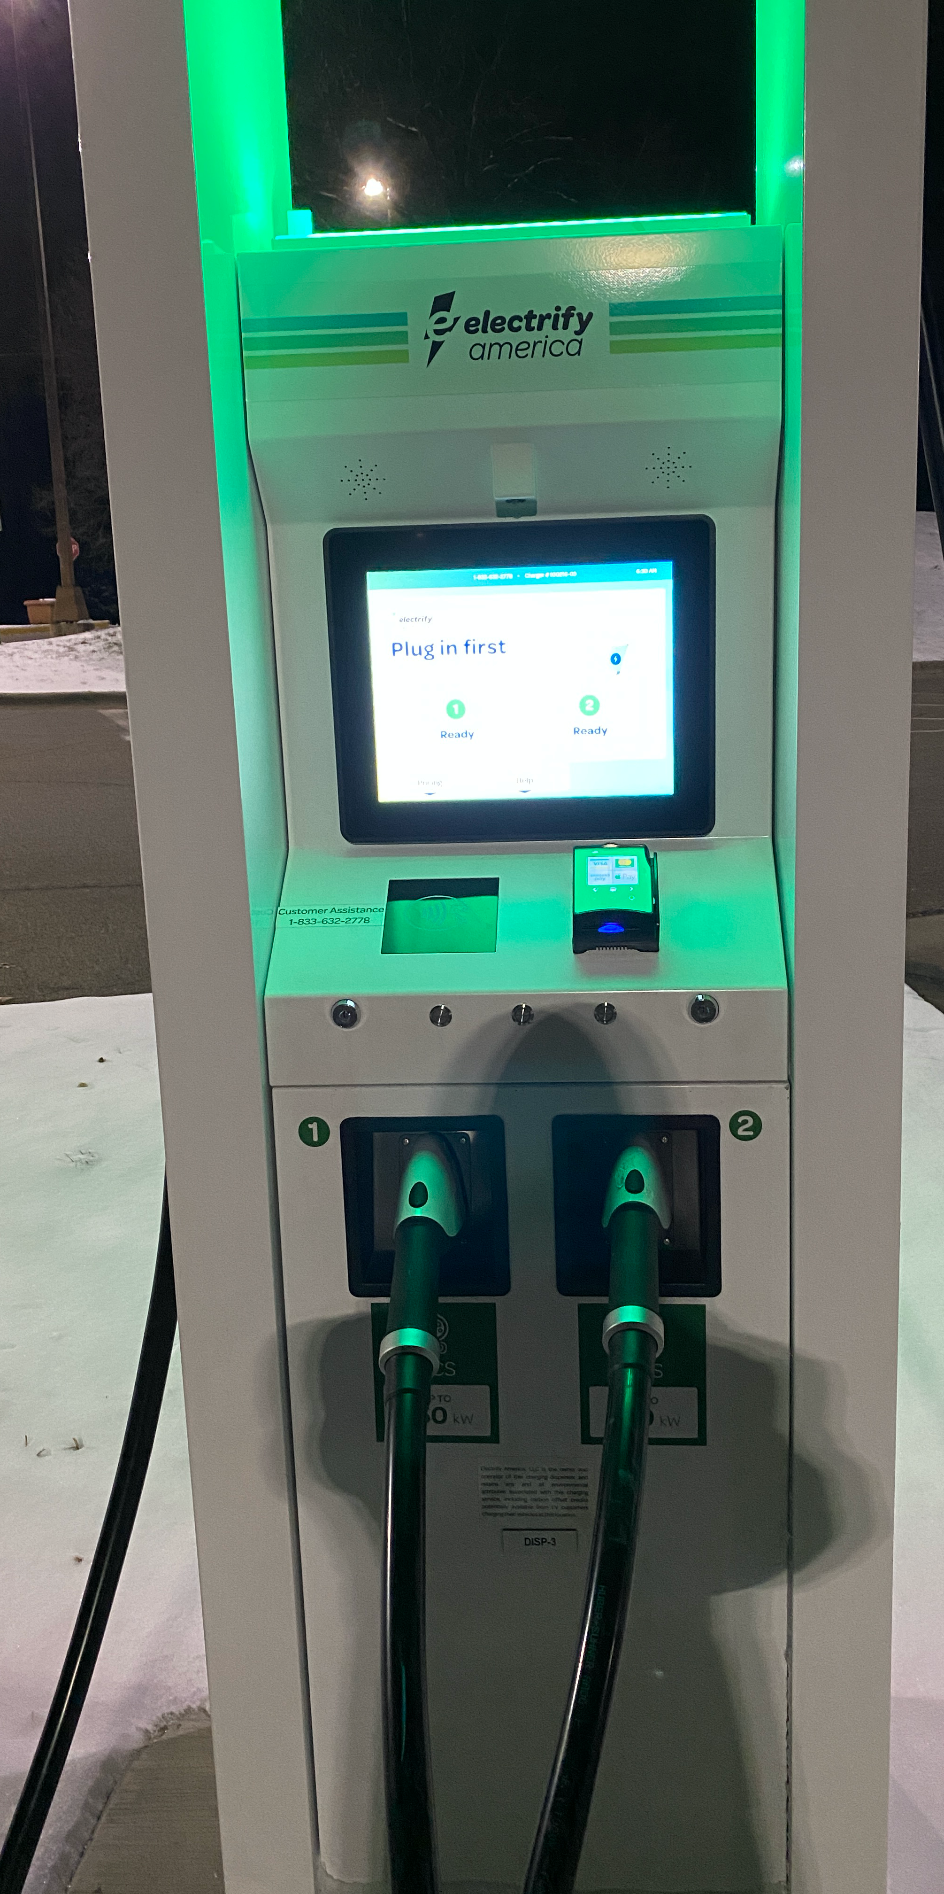


Energy: Transportation
0-60 in 2.6 s,
240 mile range…
who wouldn’t want one!
150 kW
18 MW!!
We have local charging!

Slide 16
Healthcare

Slide 17
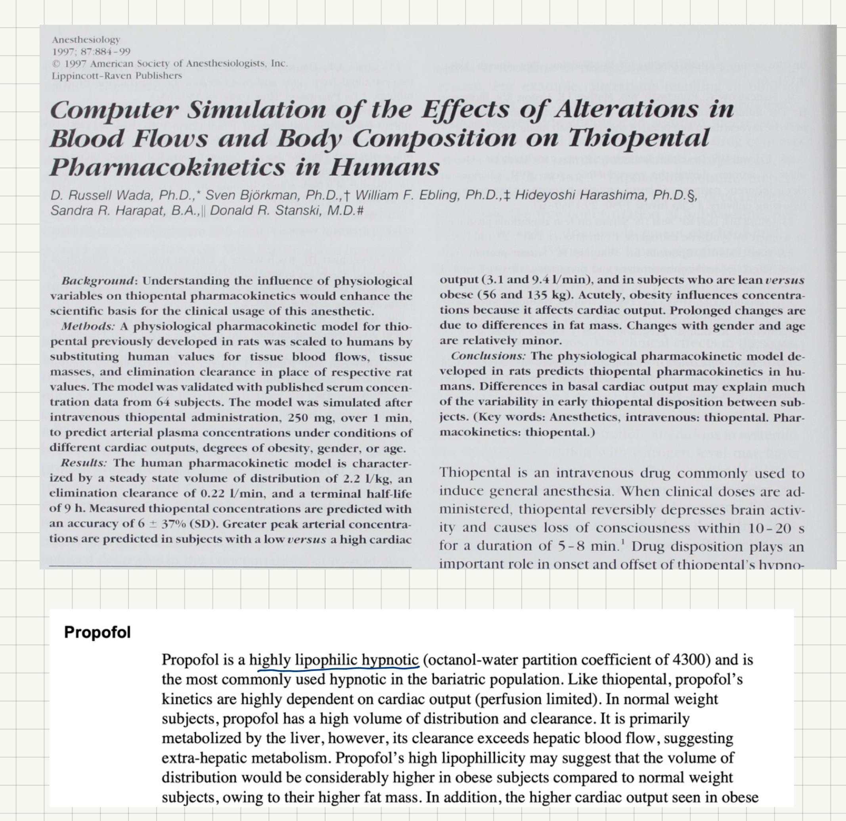
A calculation before surgery!
“Model-based control”
Precise dosing for anesthesia
Mass balances and reaction
Is this a way to possibly increase efficiency in healthcare?

Slide 18
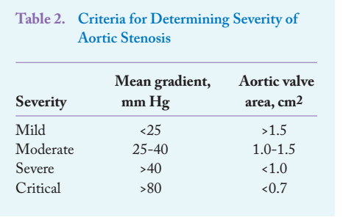
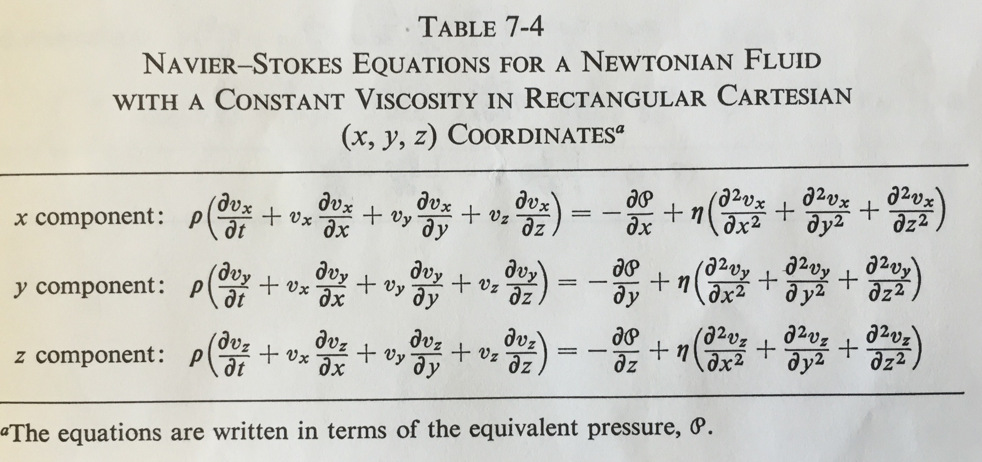
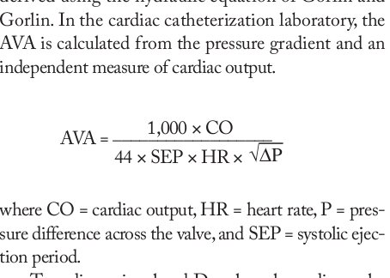
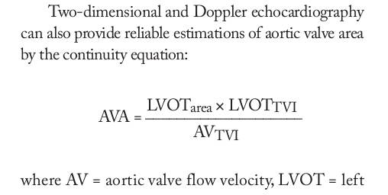
Cardiology calculation
Slide from CBE 30357
If you want to be really serious!
Flow rate varies as square root of pressure difference and linearly with area

Slide 19
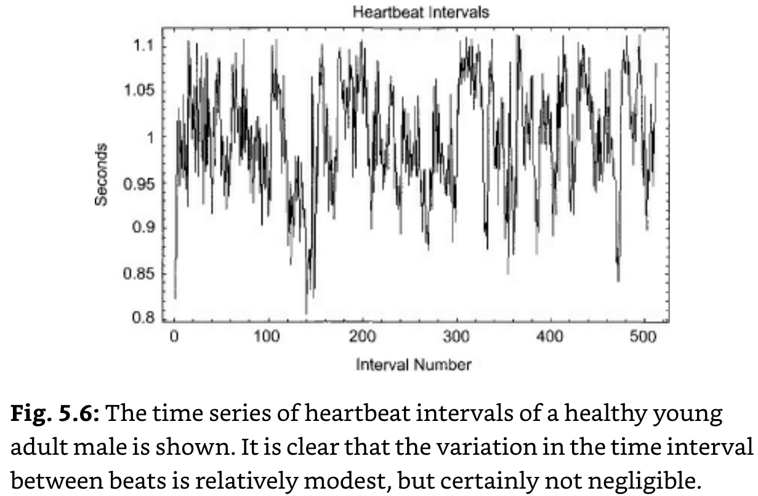
Heart beat analysis
Instantaneous R-R interval
Claim: Specific features of ECG can predict heart health and even if someone is in pain!
Chemical engineers are very good at data analysis — if we know what we are looking for and what it means… it is not “mining”
My Apple Watch does something like this!

Slide 20
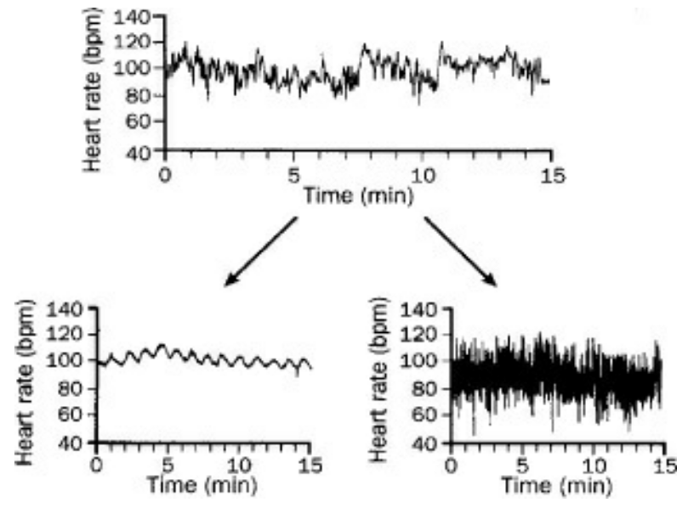
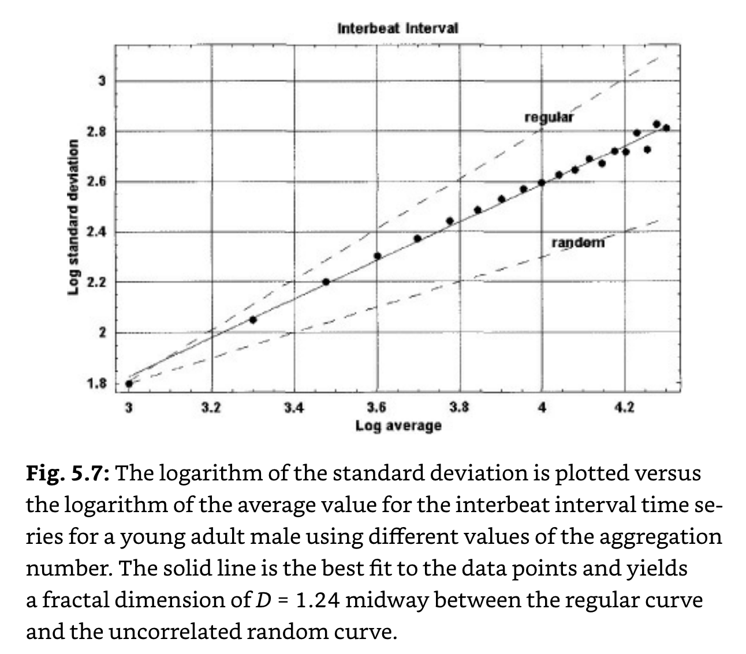
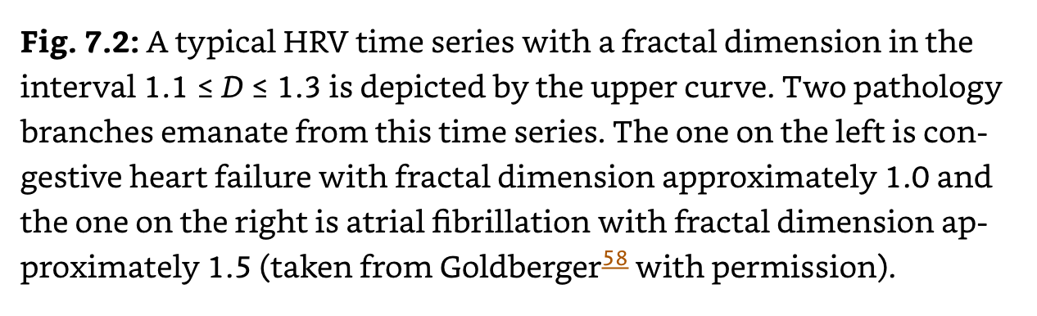
Analysis of instantaneous heart rate

Slide 21
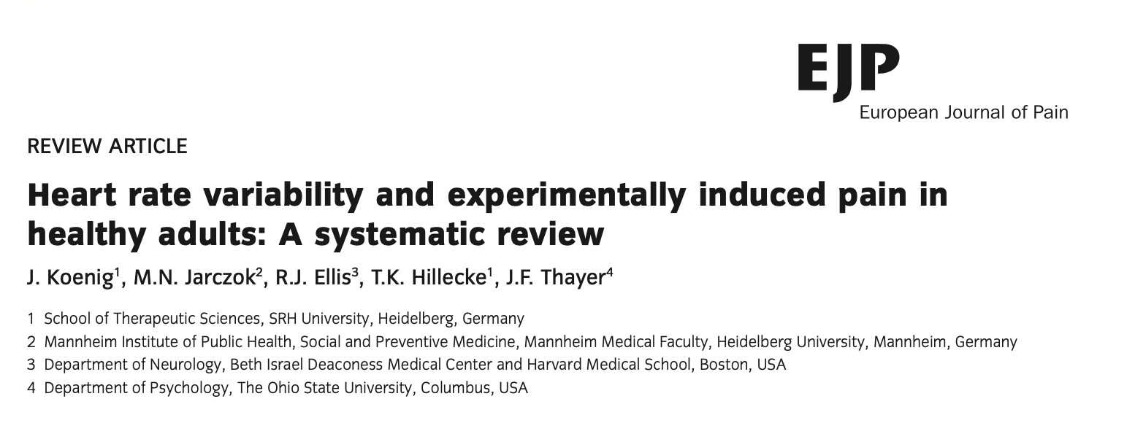
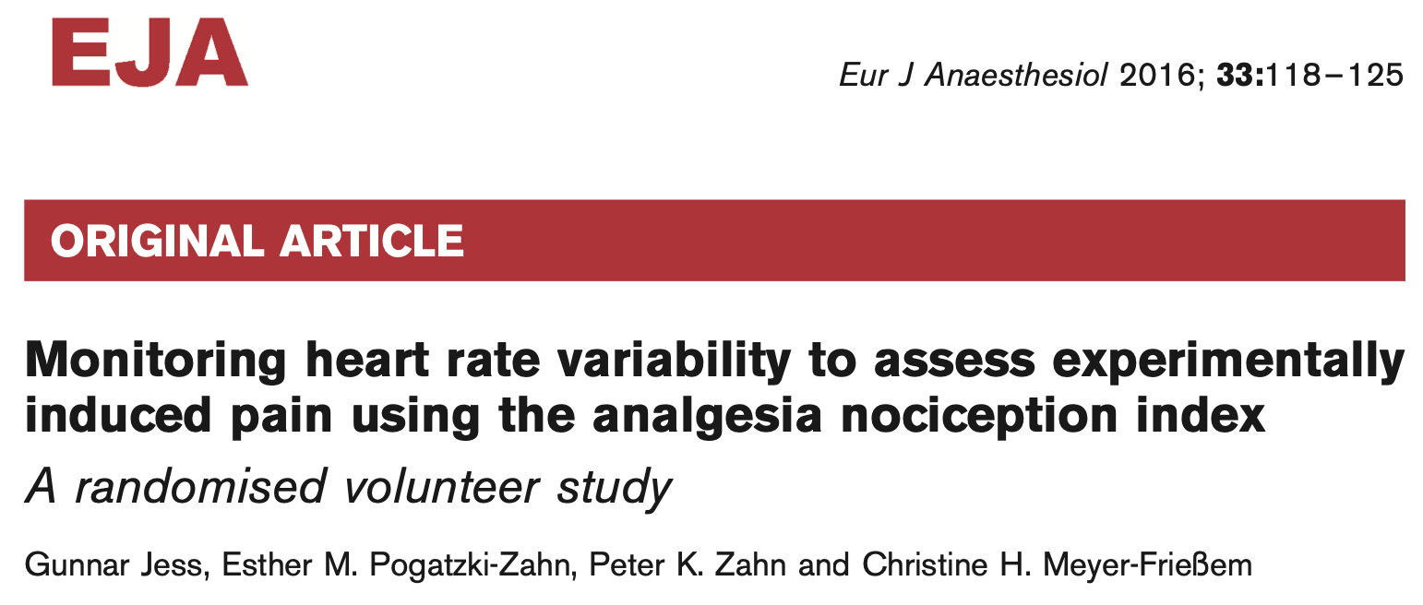
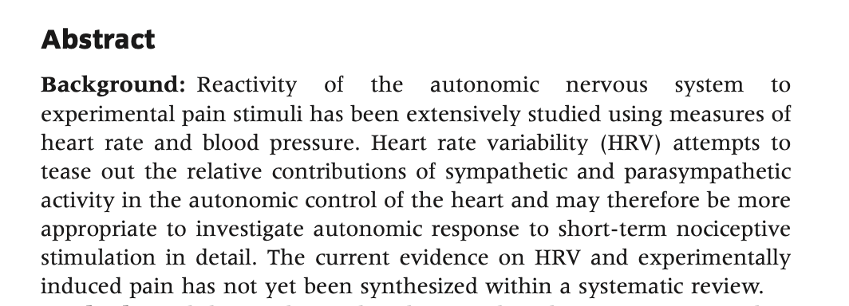
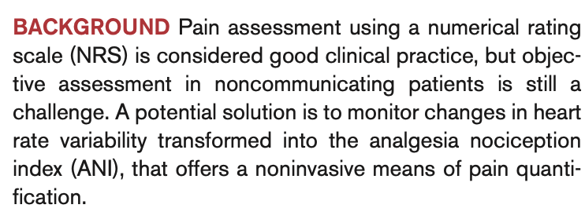
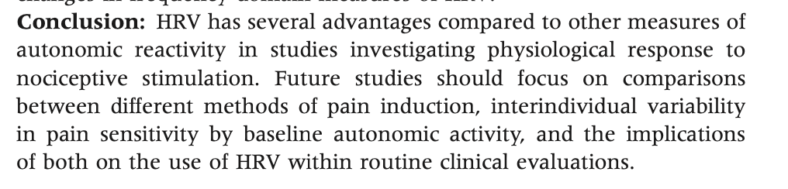
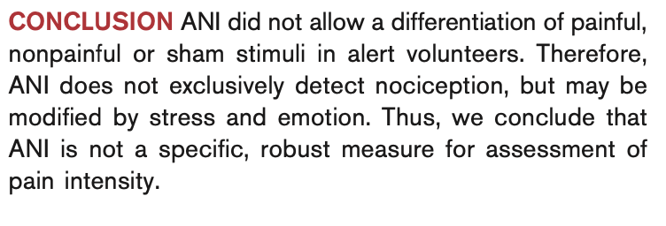
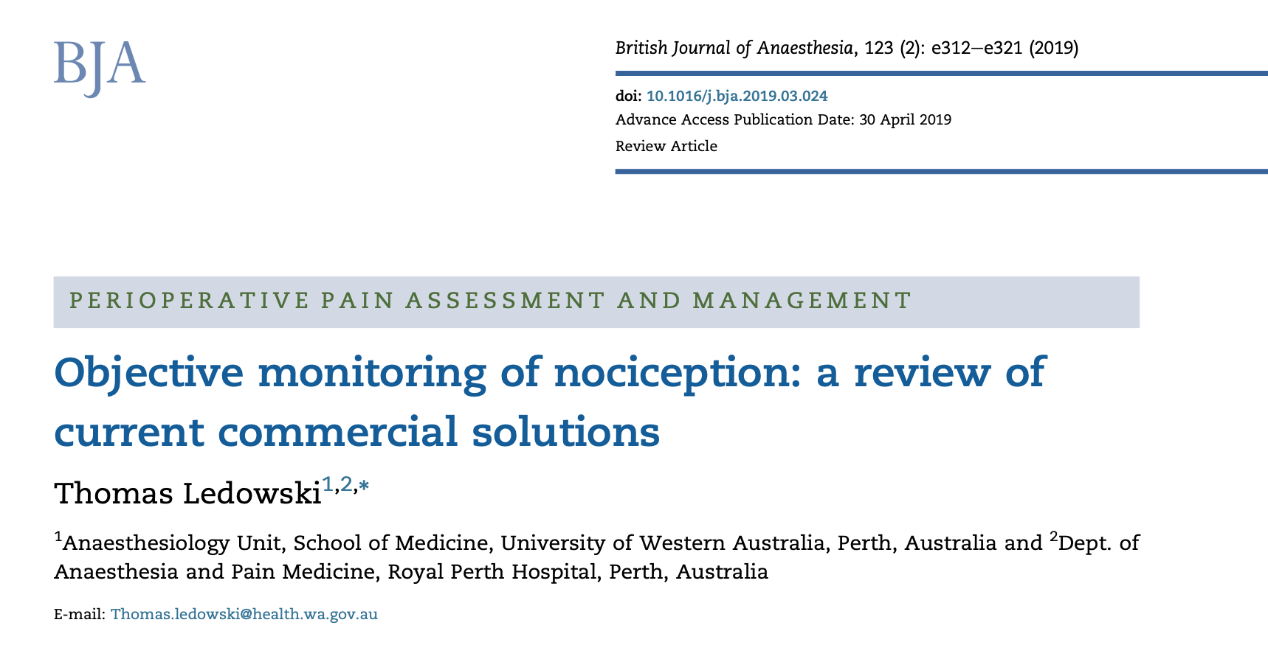
Ok, But an index for Pain

Slide 22
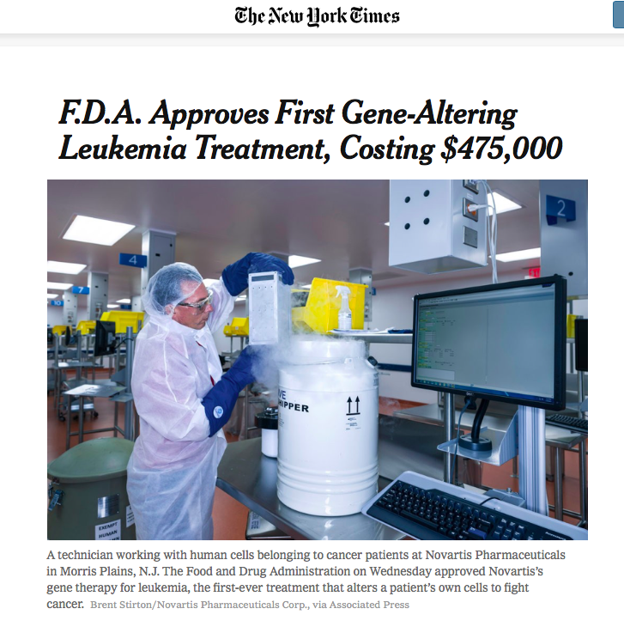
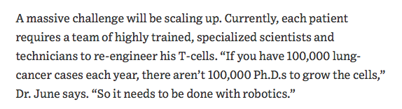
Needed contribution by chemical engineers
No, Actually, probably clever chemical engineering!

Slide 23
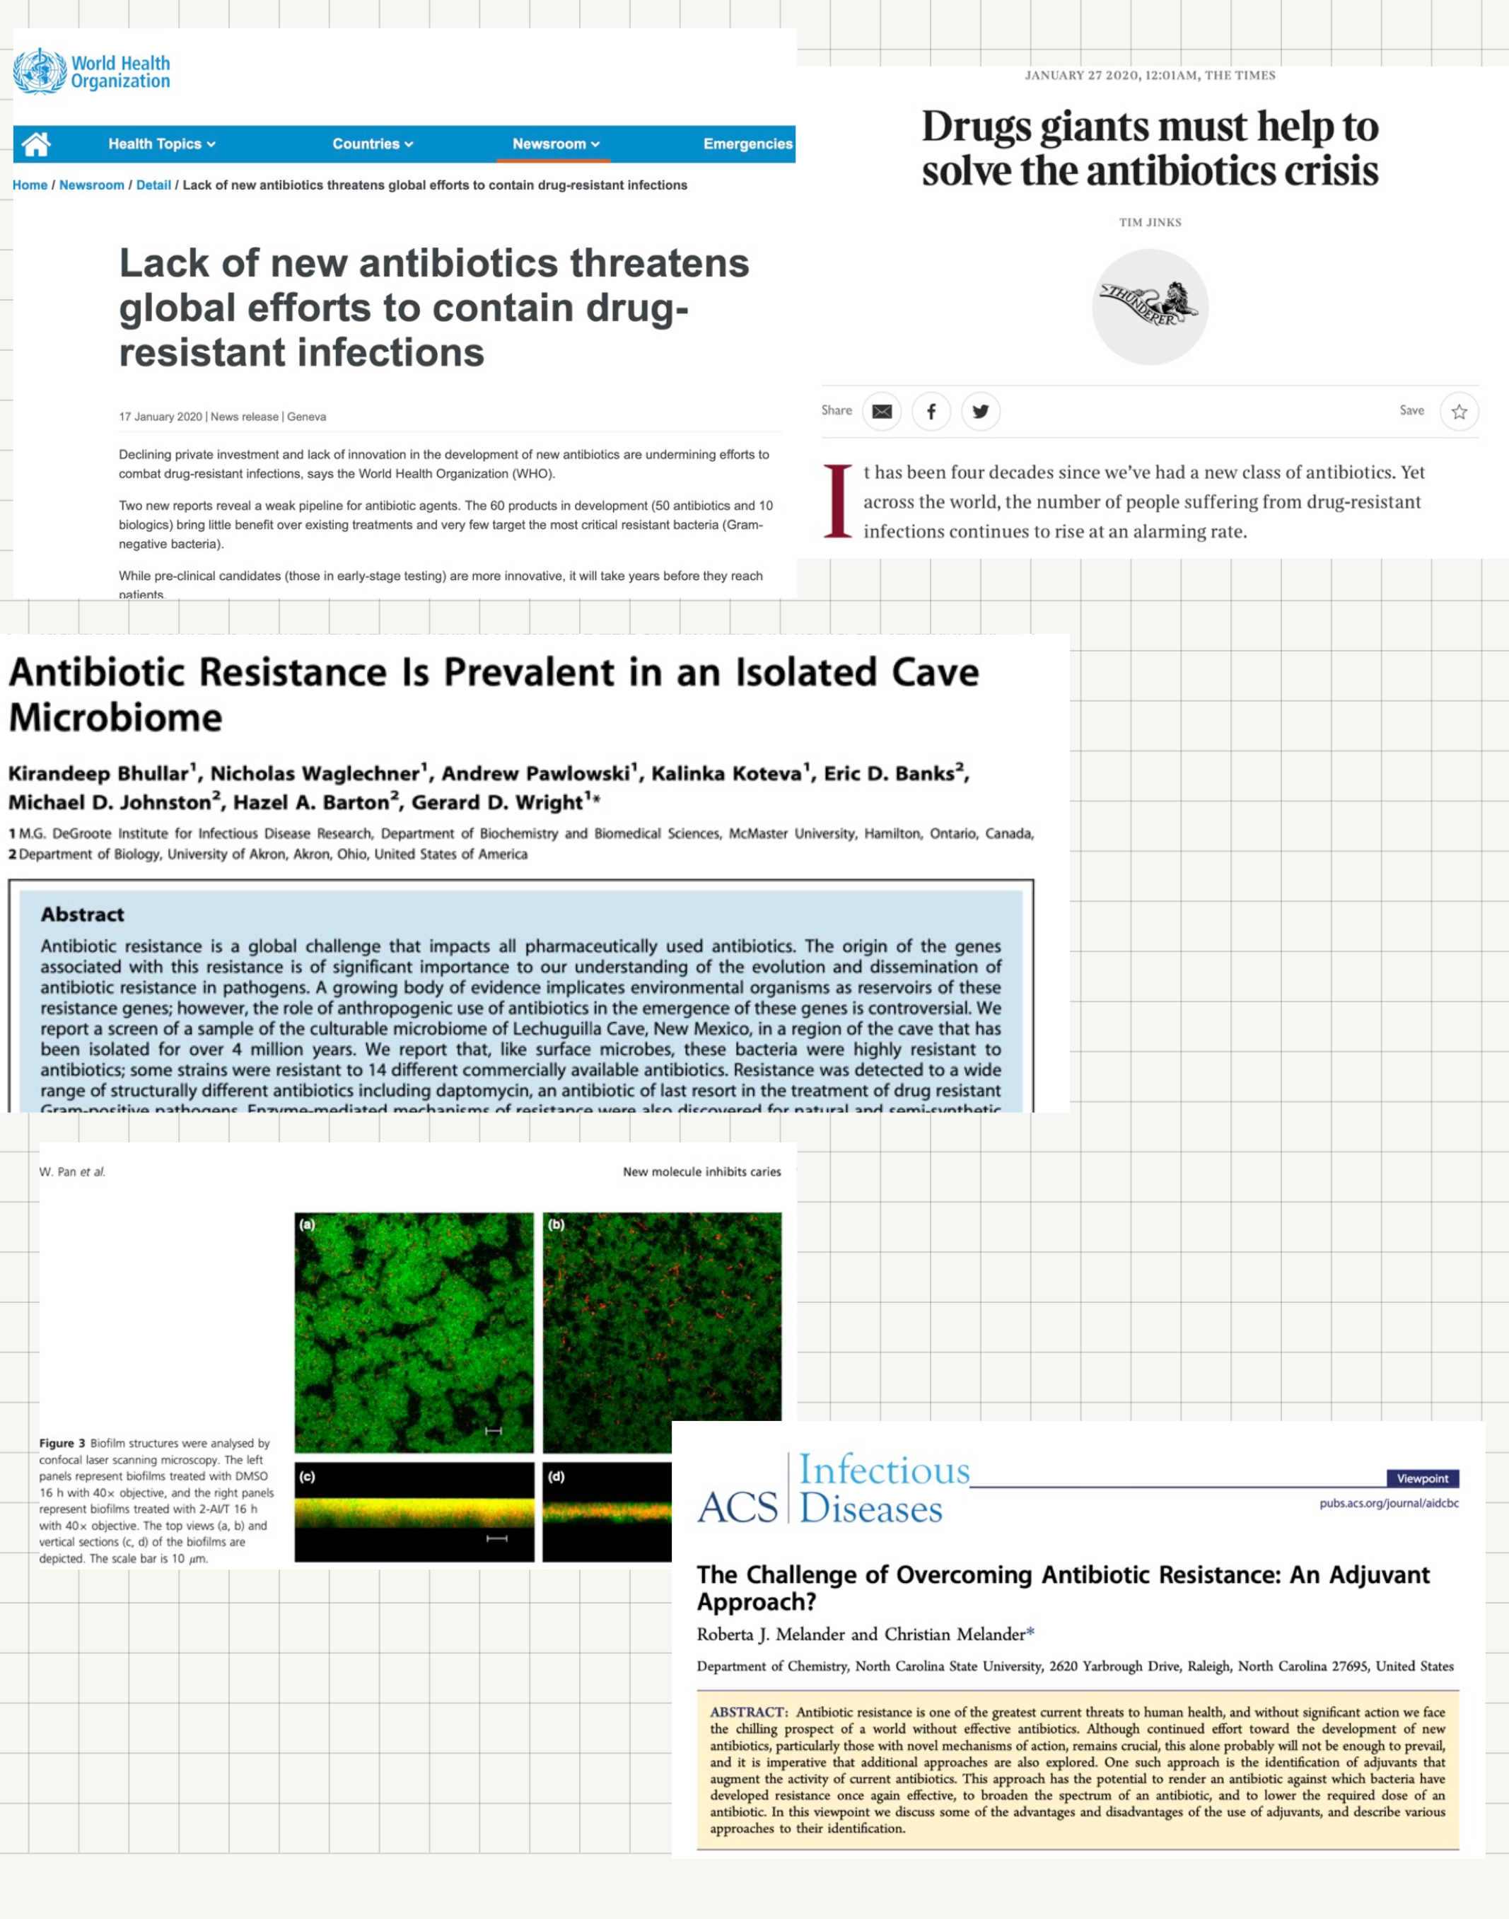

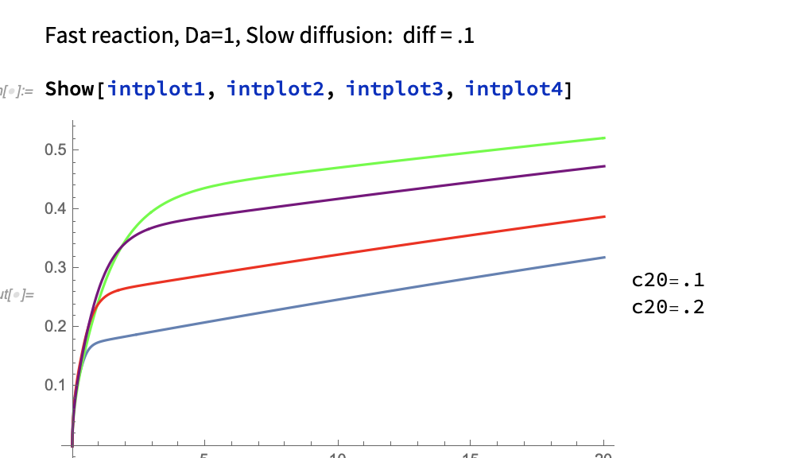

Slide 24
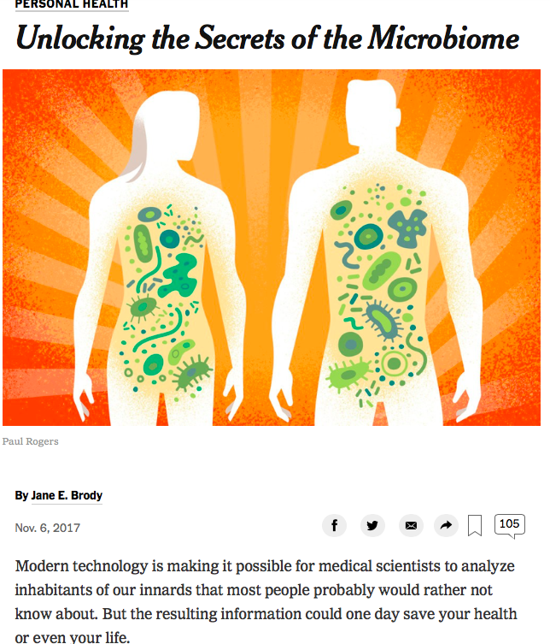
Contribution of engineering
This is a “systems” problem as much as a biological problem.
How can we keep track of and interpret all of the biological data!

Slide 25
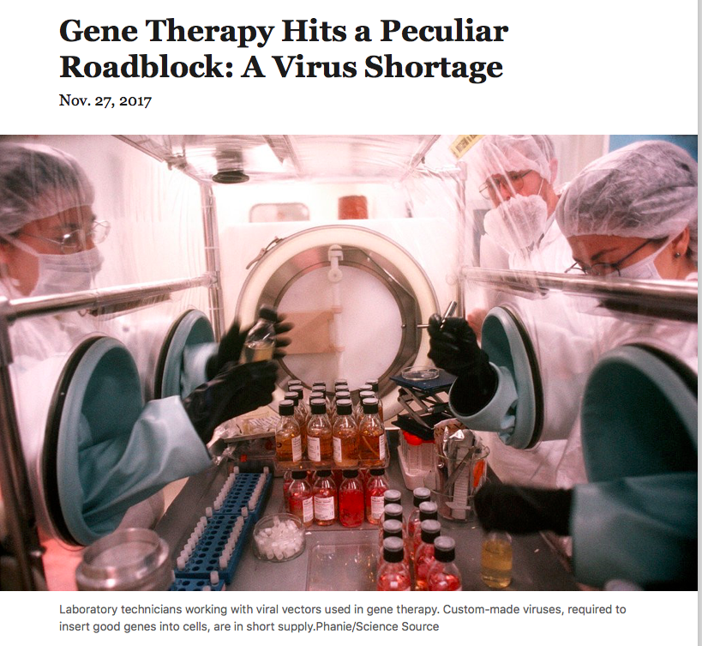

Biomedical Engineering

Slide 26
“Tassel” List
(academic)
Go with your lab or HW group for breakfast or lunch with one of the faculty
“voluntarily” take a deep academic experience e.g., figure out what the 2nd law really means, or what a normal viscous stress is or figure out why infinite domain transport problems have similarity variables naturally arising.
  we can help!
Ask a really perceptive question in class, or any question if you have never done it!
Compliment a faculty member on a particularly good lecture

Slide 27
Tassel list (continued)
Explain (e.g.,) the utility of knowing the consequences of the first law of thermodynamics when, say, making green energy policy at ND, to a non-engineer !
Read a publication written by one of the faculty members and discuss it with him or her over coffee.
Attend a department research seminar or a similar seminar in another department
Develop a fully-informed and well thought out position on an important world problem
Make a constructive suggestion for course improvement on the CIF

Slide 28
Summary
Chemical engineers have knowledge and understanding that is both unique and useful far beyond chemical process technology
We (as in you) are prepared to make seminal contributions to the future of society
  — enjoy!

Slide 29
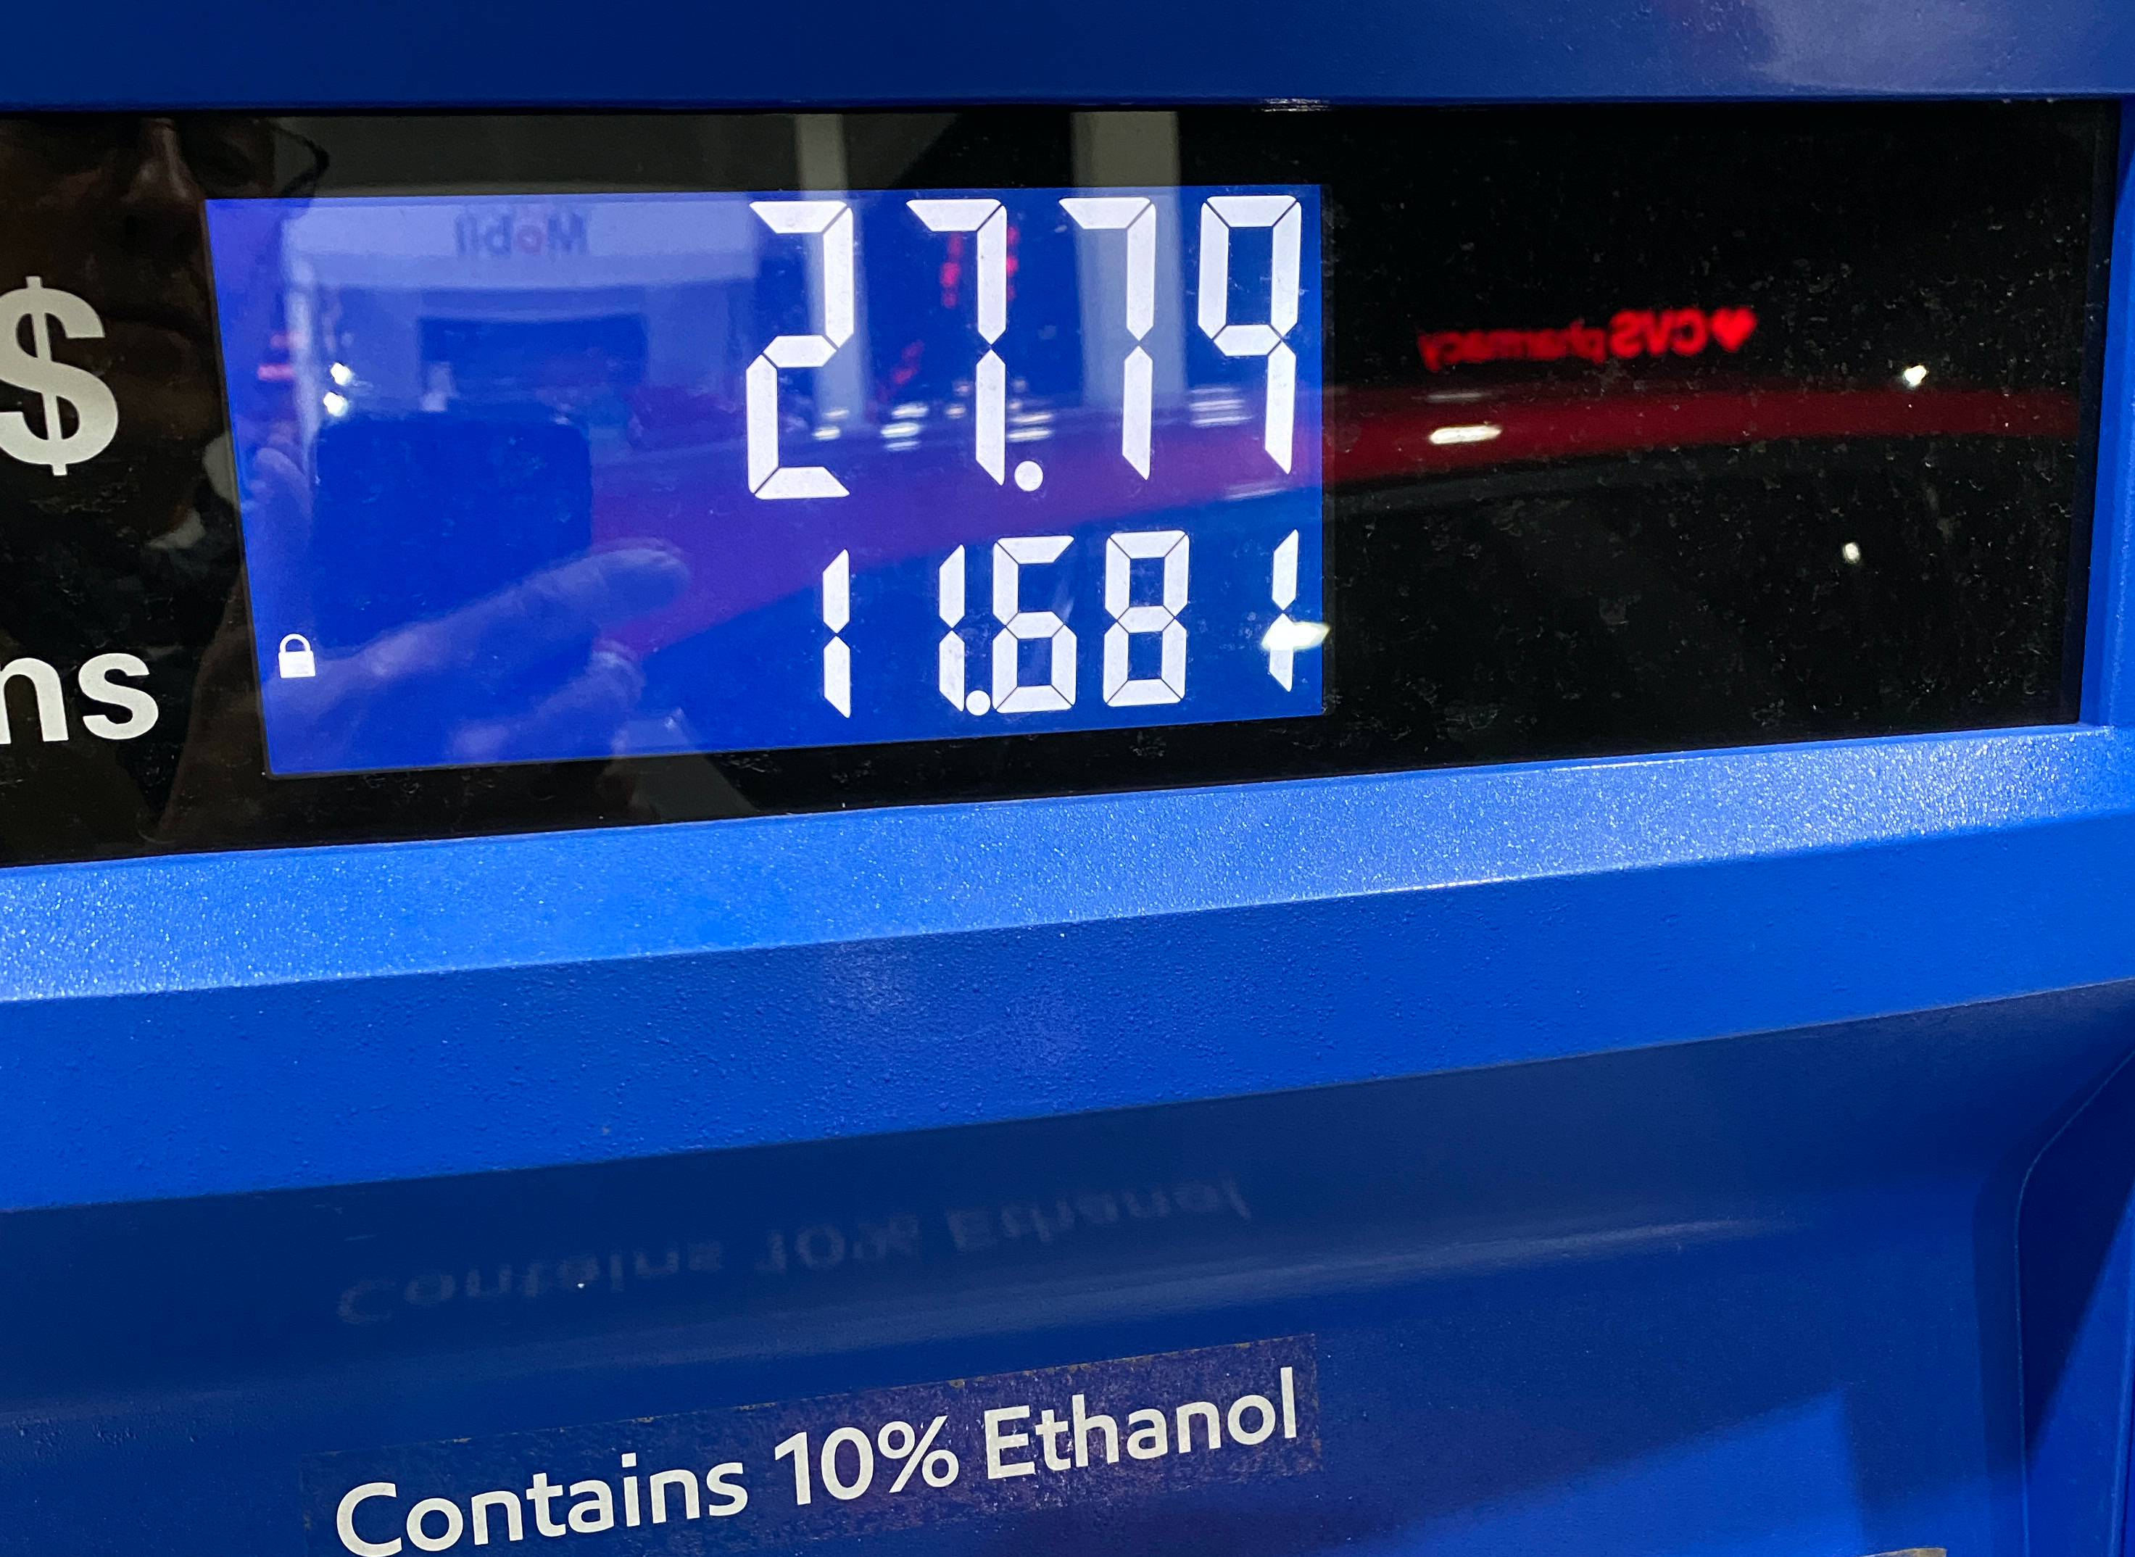




~ 340 miles

